Slide 1
Final Report - Team C
Eric Gaudreau, Raghu Nema, Mariano Amaya, Sam Dvorin, Shangyuan Chen

Slide 2
From Early Insights Report

Slide 3
Project Summary
The city of Boston is interested in a report regarding the nature of animal complaints on the city’s 311 app. This includes the number of complaints, kinds of animals, distinct geographic areas where animal complaints are common, and trends in said complaints (such as season, or weather).

Slide 4
Early Insights Key Questions
Data Source
How many reports were there in the previous 2-3 years? 5-10 years? Are there any positive or negative trends to these reports (decreasing in sum total, etc)?
How do other factors such as season impact the nature of the complaints? (ie: are there more complaints in the summer? Winter?)
Analyze Boston Yearly 311 Service Requests in CSV file format (Years 2011 - 2023)
Used Python File to Parse all Requests Relating to Animals
Link: https://data.boston.gov/dataset/311-service-requests

Slide 5
GENERAL TRENDS

Slide 6
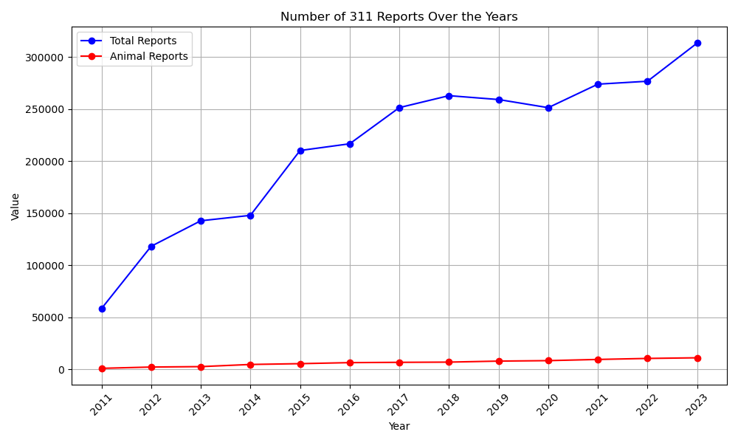
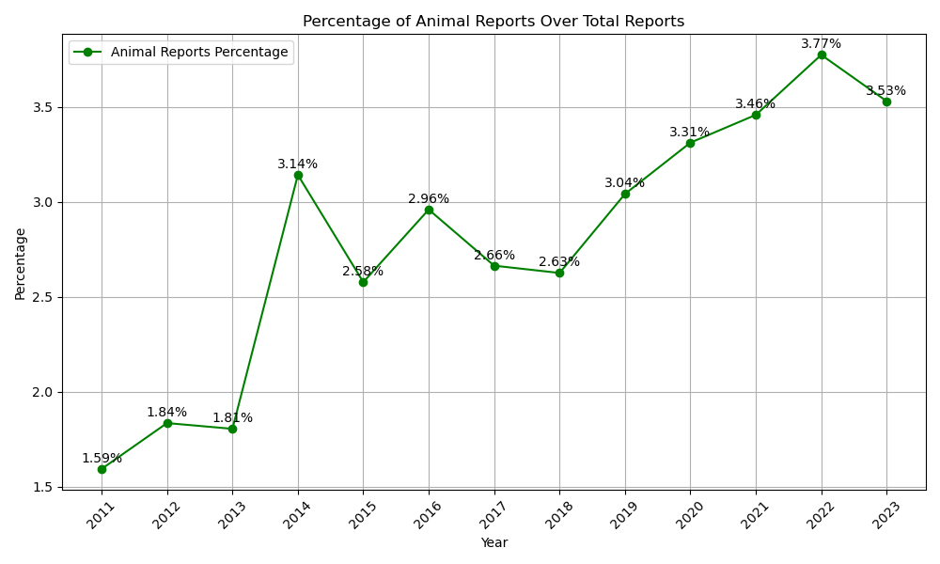
TRENDS:
Steady increase over the years
Growing proportion of animal related issues within the total number of reports submitted to the city’s 311 system, especially notable in recent years.
ANALYSIS: The steady increase in total reports could be due to several factors
Growth in the population leading to more incidents being reported
Increased awareness or ease of reporting through the 311 system

Slide 7
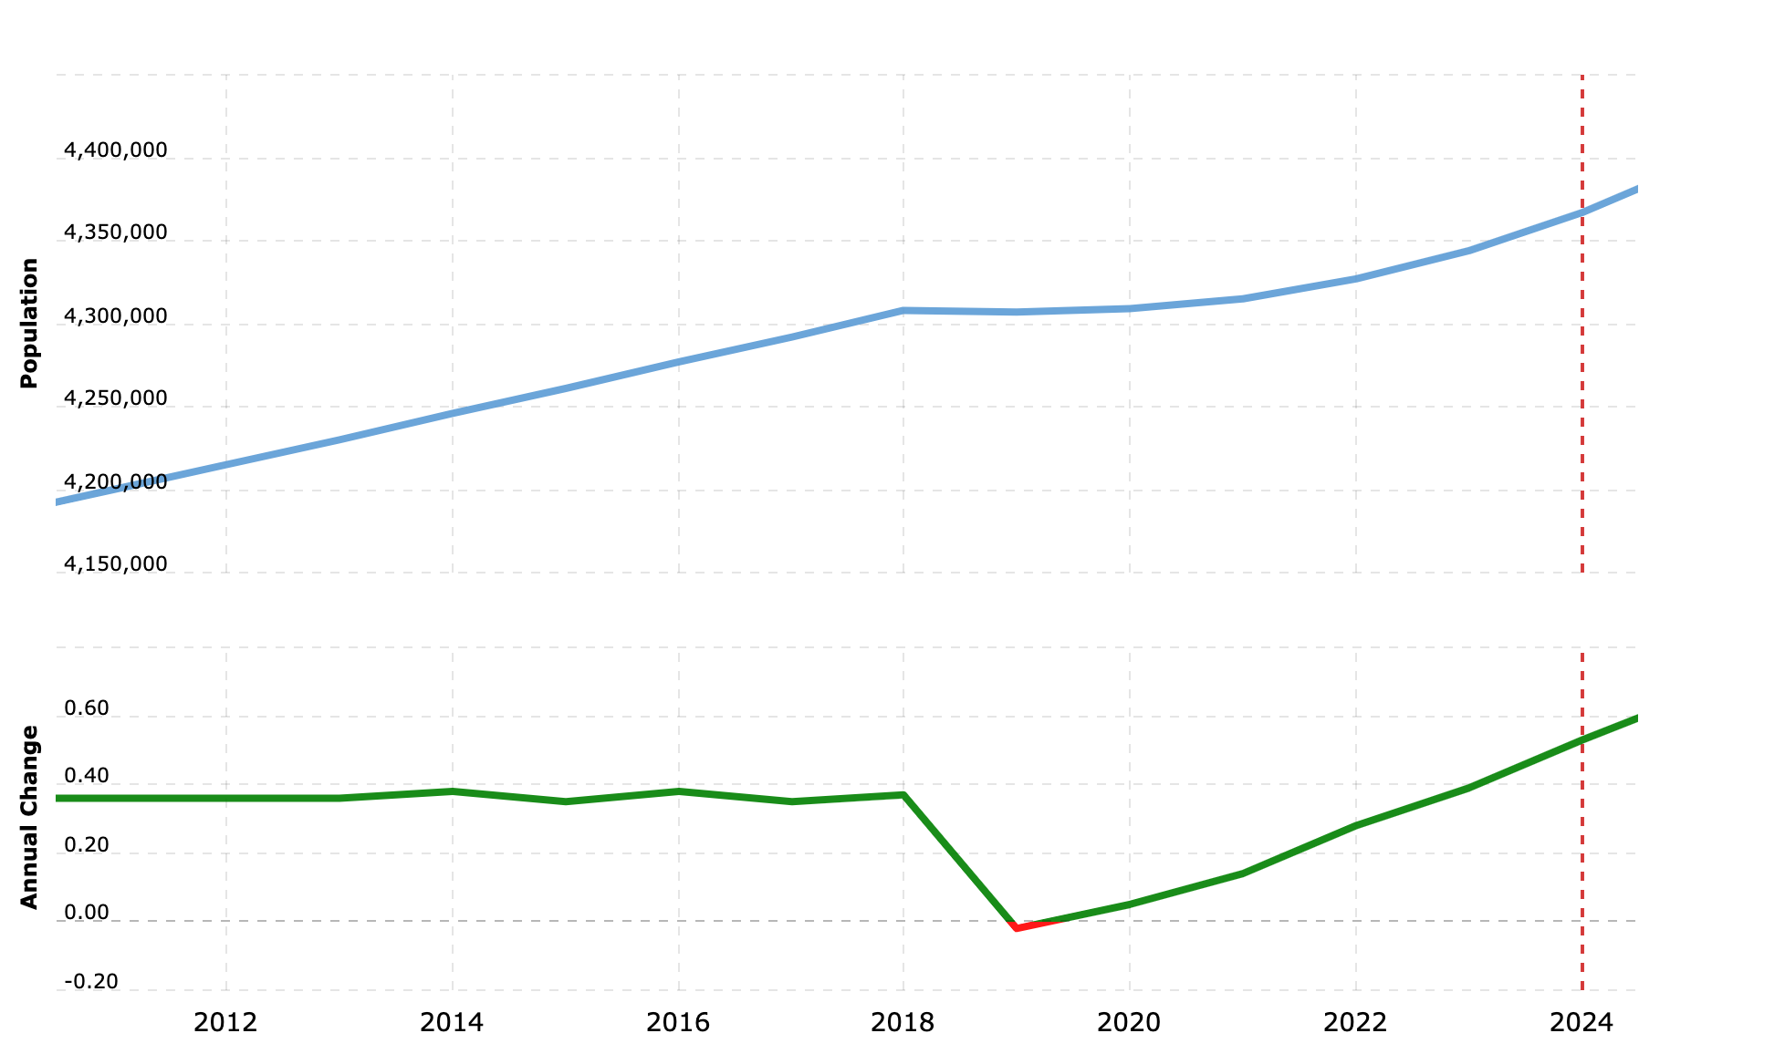
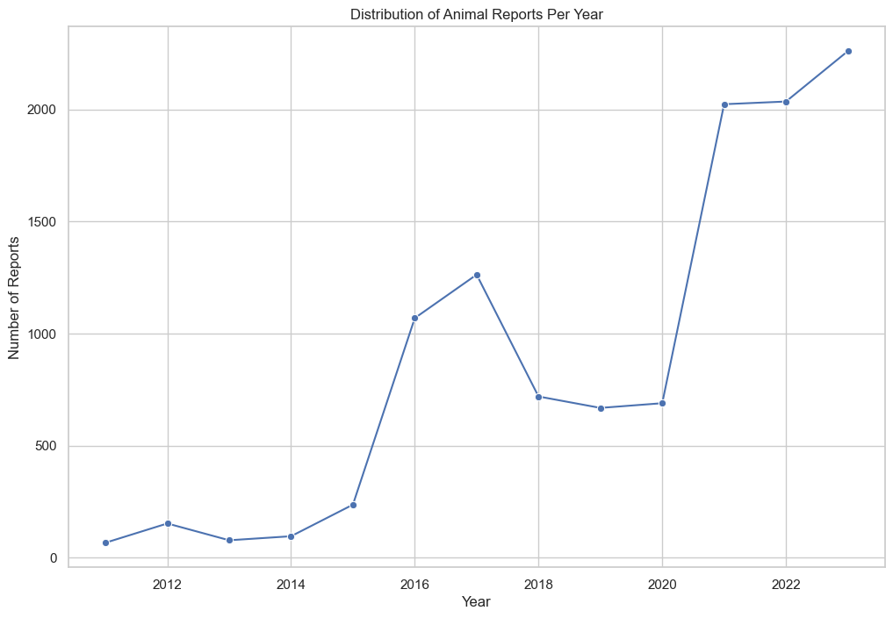
Total Boston Population vs Animal Requests
Data From: https://www.macrotrends.net/global-metrics/cities/22939/boston/population
Analysis: Boston population is not strongly correlated with number of animal requests even though the directionality is the same

Slide 8
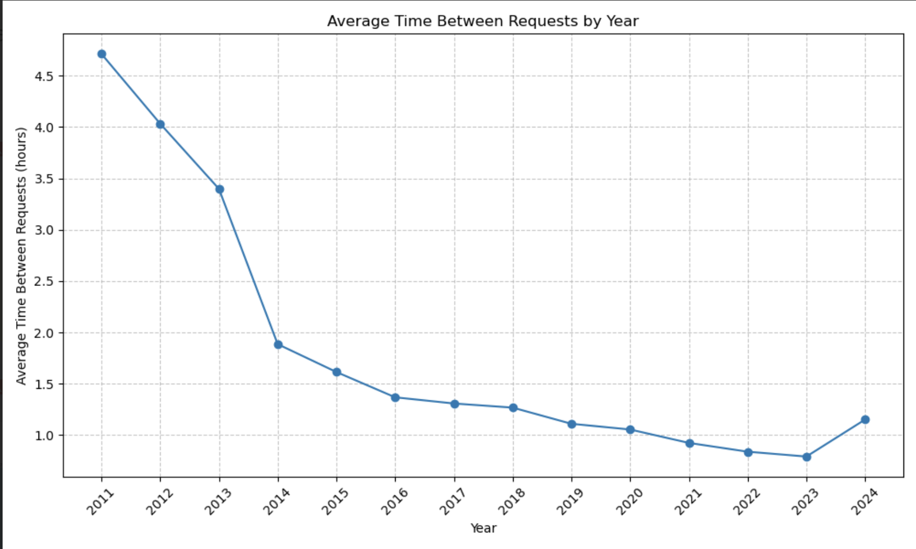
TRENDS:
Decrease in time in between requests and year
Slight increase in time between requests in 2024, but since data is incomplete and there is no future data, there is no definitive say there is an increase in the times
ANALYSIS:
The increased amount of requests per year corresponds to the time in between requests decreasing
The sharp decrease in time in between requests could be due to an implementation of a new system for reports, better awareness and ease of submitting requests could lead to shorter times

Slide 9
TEMPORAL FACTORS

Slide 10
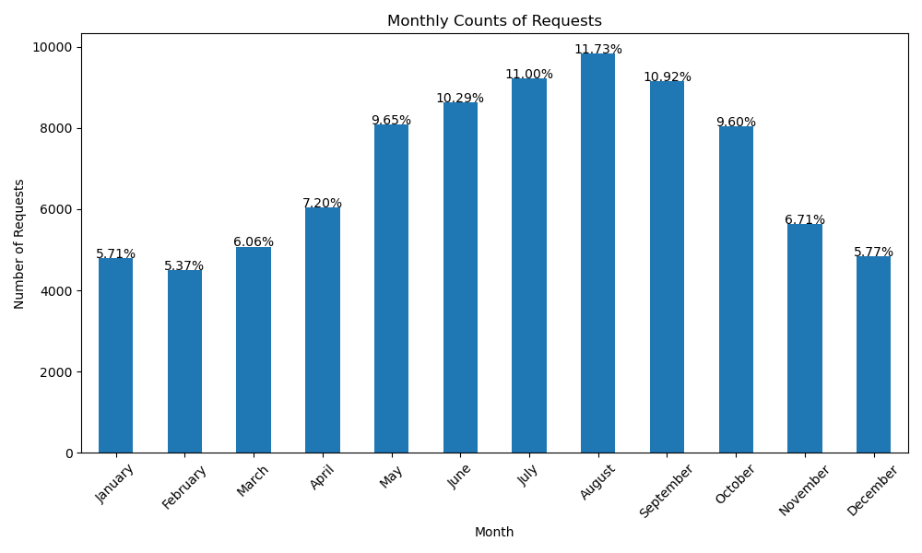
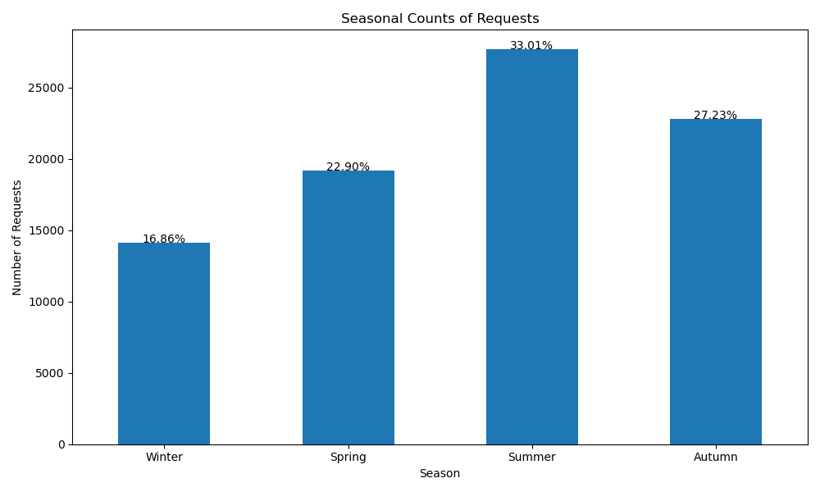
ANALYSIS:
Increased human outdoor activity, longer days, warmer weather may lead to more sightings
Animals may exhibit heightened activity levels during the summer, such as breeding or foraging behaviors, causing encounters with humans.
TRENDS:
There is a peak in the amount of animal reports during the summer months

Slide 11
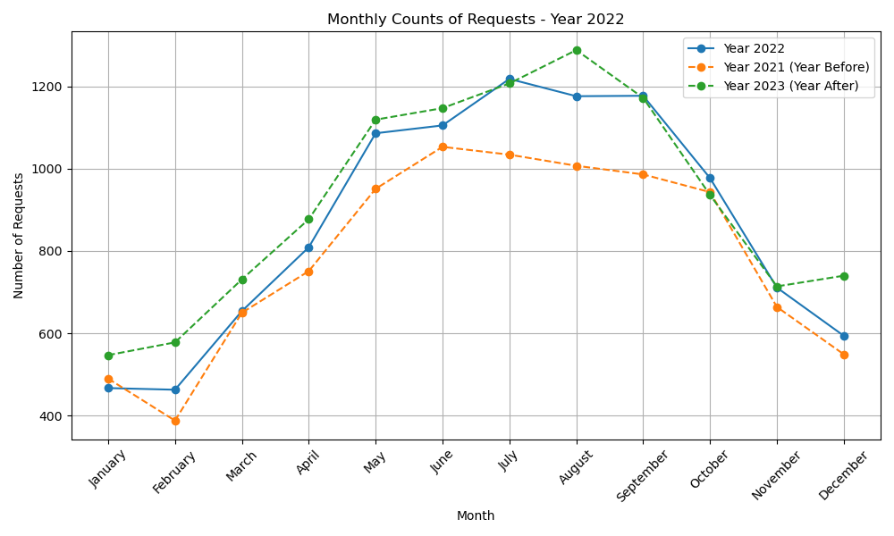
TRENDS:
Warmer months typically have an increase in complaints.
Significant decrease from July to December could be due to colder weather, which could lead to a reduction in animal activity and consequently fewer complaints.
An increase in the request counts from the 2023 data compared to 2022, which could suggest an increase in public awareness campaigns.
ANALYSIS:
It would be beneficial to examine any concurrent events such as like new city initiatives, or demographic changes.
Correlating the data with weather patterns, geographic information, or city events could provide more insights into the causes of the trends.

Slide 12
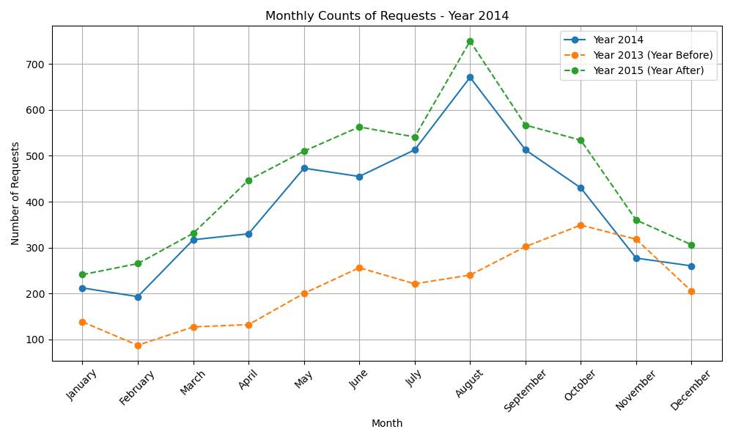
Important Note: Highlights year of greatest increase in Animal Reports (2013 to 2014)

Slide 13
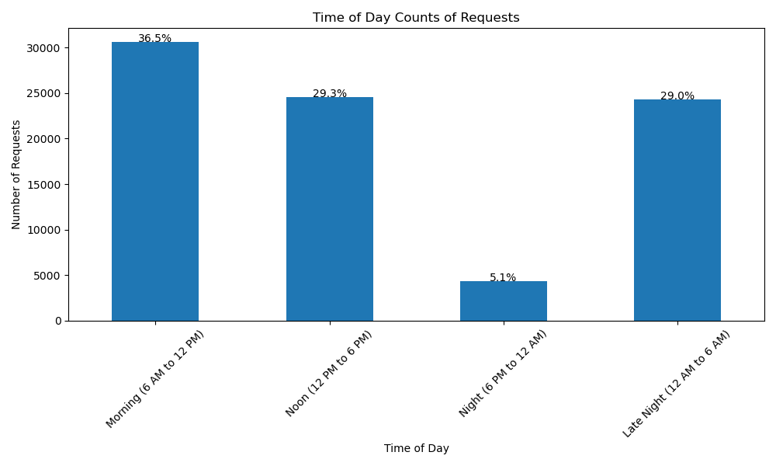
TRENDS:
Most reports are received in the morning, but there is also a high peak for late evening
The number of reports is extremely low during Night time
ANALYSIS:
When people wake up in the morning they report anything that has occurred overnight
Late night reports could be due to nocturnal animals, specifically rats.
Most people are sleeping during the night, which would account for the low report number

Slide 14
From Mid-Semester Report

Slide 15
Mid-Semester Key Questions
Where are the complaints coming from geographically? Is there any trend to type of animal complaint and area?
What kinds of animals are most common in complaints? (Rats? Domesticated pets? Dogs? Cats?)
Notes:
Are the potential questions worth pursuing. Do you want us to see something like this?

Slide 16
ZIP CODE

Slide 17
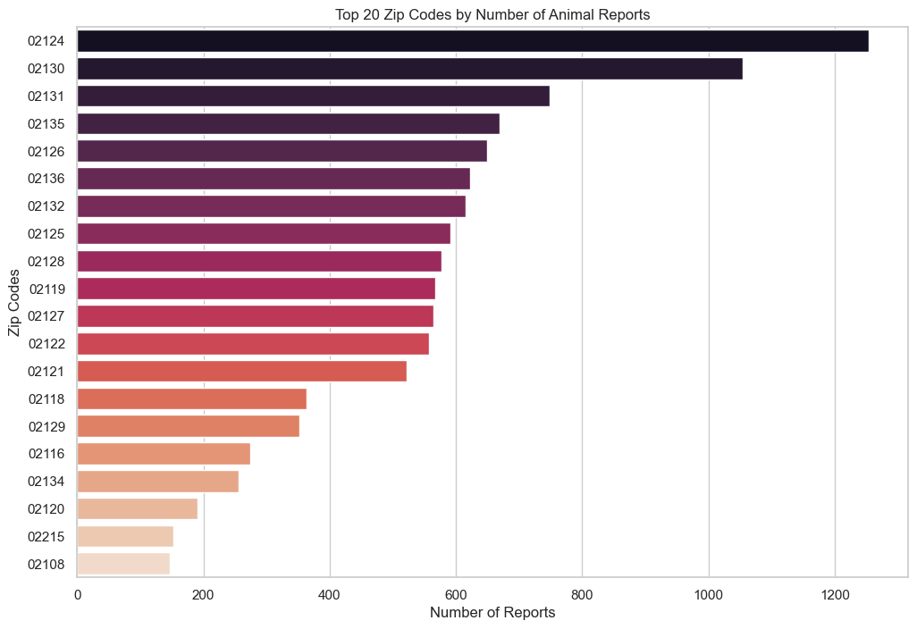
Zip Codes
Trends
02124 highest number of requests
After the top two zip codes, there is a discernible decline in the number of reports
Indicate a more managed or smaller animal population, or possibly fewer occurrences worthy of reporting.
Analysis
Discrepancies in report counts could be influenced by population density, with more densely populated areas possibly having more human-animal interactions.
Areas with more green spaces or closer to natural habitats may experience more wildlife encounters, increasing reports.
Higher pet ownership rates in certain zip codes could contribute to the number of reports.

Slide 18
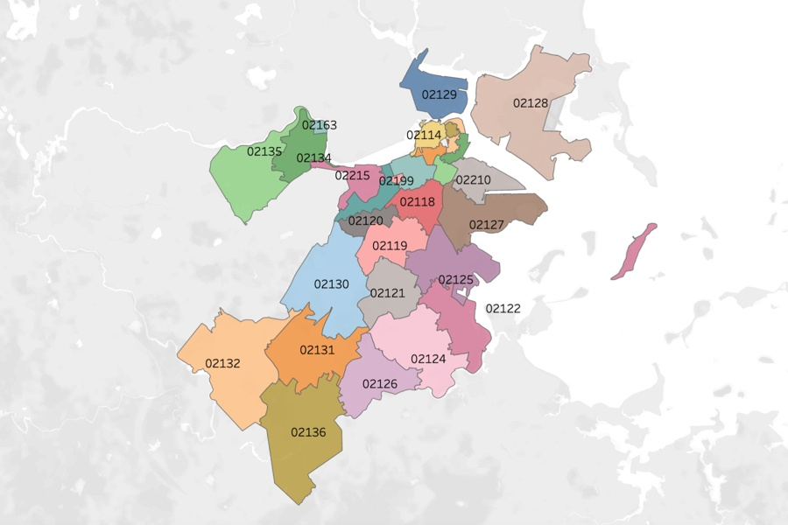
Zip Codes with the Highest Report Number
02124
DORCHESTER CENTER
Population: 47,783
Land Area: 3.00 sq mi
Population Density: 15,913 people per sq mi
02130
JAMAICA PLAIN
Population: 35,401
Land Area: 3.33 sq mi
Population Density: 10,618 people per sq mi
Potential Extension Project!
Looking Deeper into Zip code Stats and Demographics (https://www.unitedstateszipcodes.org/)

Slide 19
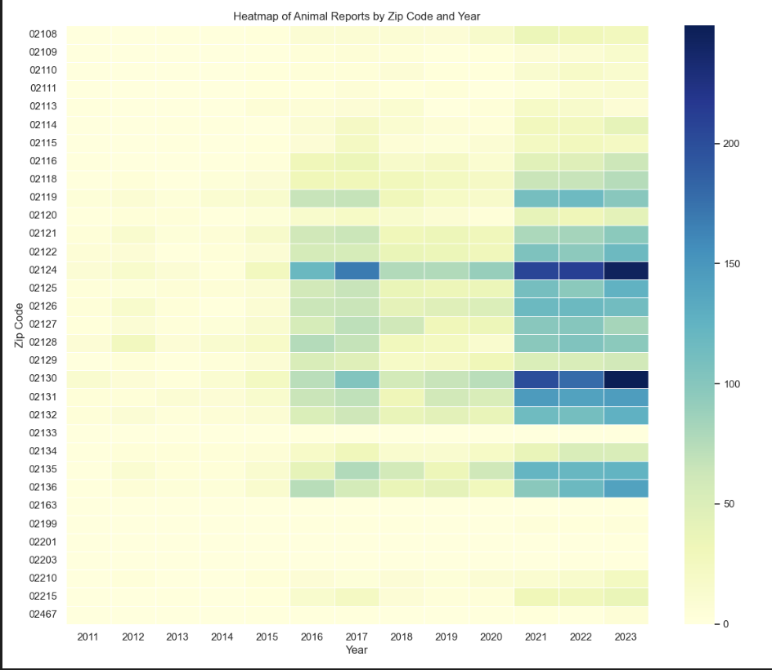
Zip Codes (Continued)
Trends
The heatmap shows the frequency of animal reports from 2011 to 2023 across different zip codes.
The consistent presence of lighter colors (yellow-green) in the early years across all zip codes suggests fewer reports or less comprehensive data collection during that period.
Zip codes 02124, 02125, and 02130 have notably darker squares
Analysis
Yearly Variations: Some years show an even spread of reports across zip codes, while others display a concentration in specific areas

Slide 20
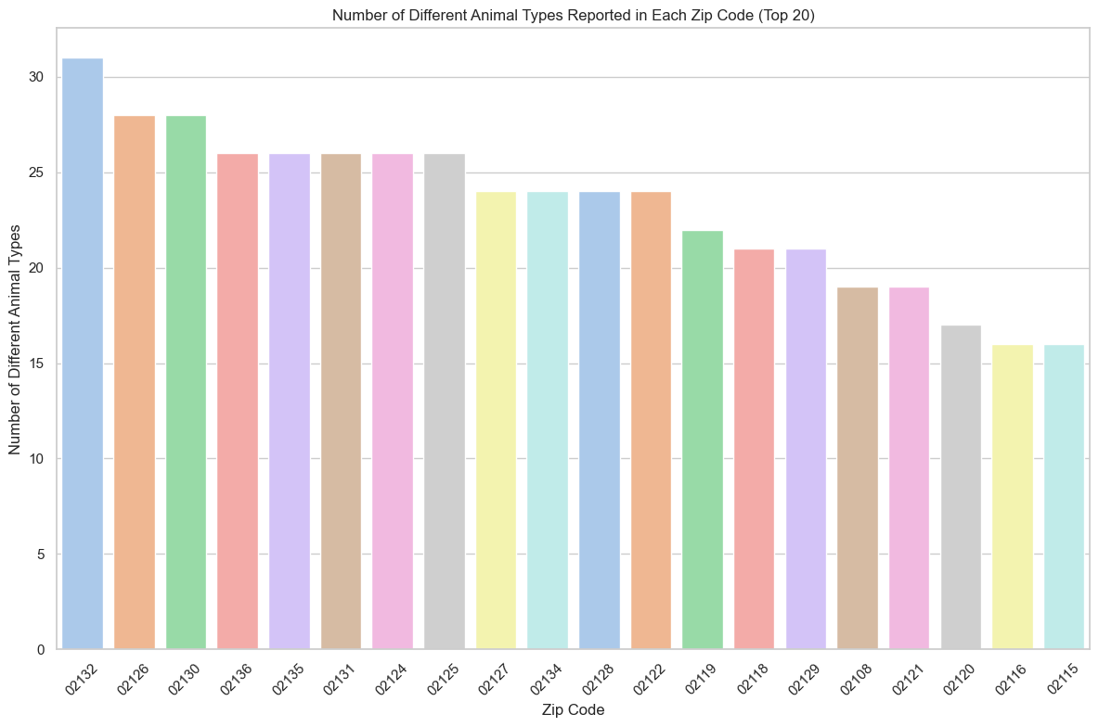
Zip Codes and Number of Unique Types of Animals
Trends
Zip-codes close to each other have similar amount of different animals, meaning that there code be animal burrows or nests that cross zip-code boundaries
There is only a gradual decrease meaning that there isn’t a large amount of difference between the zip-codes
Analysis
Shows that there are a significant amount of zip codes that have more than 15 different types of animals, showing that each zip code has a variety of different animals
Higher pet ownership rates in certain zip codes could contribute to the number of reports.

Slide 21
Yearly Heatmap of All Animal Requests
2013
2023

Slide 22
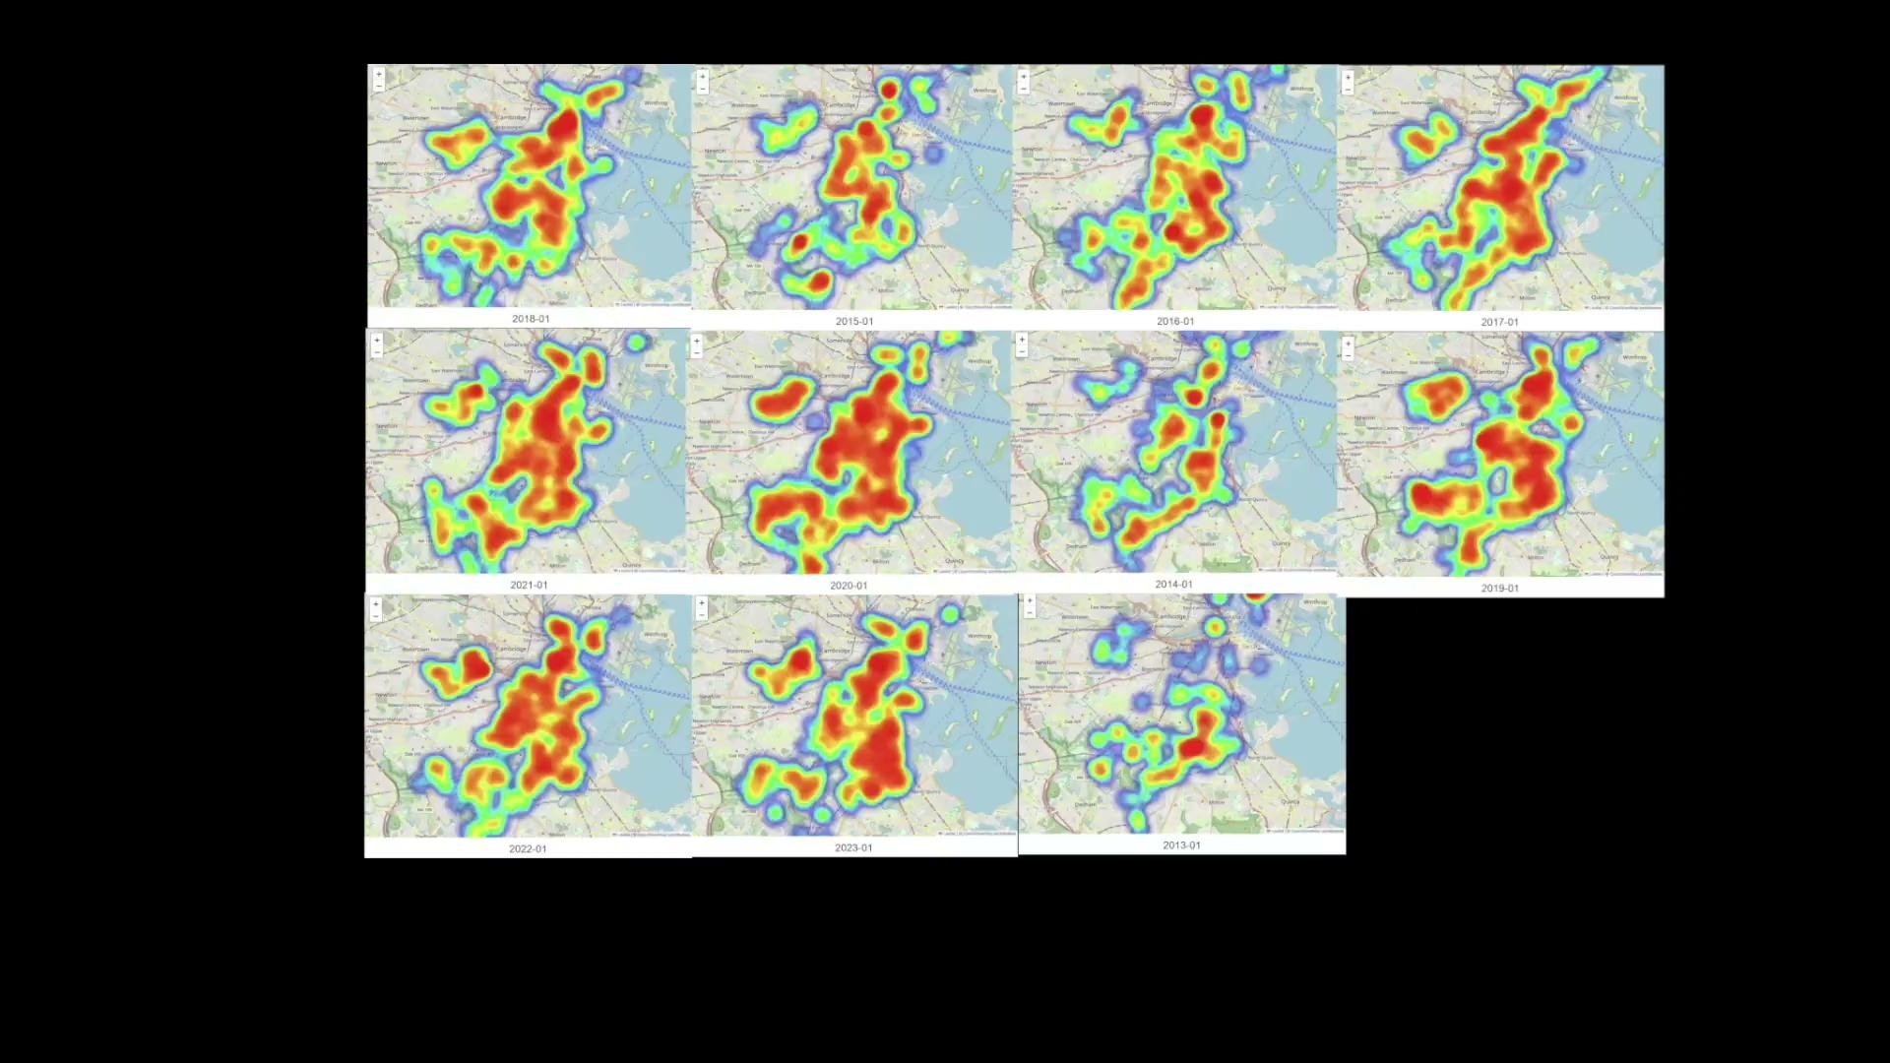
Heatmaps of every year next to each other
Analysis:
Heatmap looks like its blooming with the spring and summer months of the year

Slide 23
ANIMAL TYPES

Slide 24
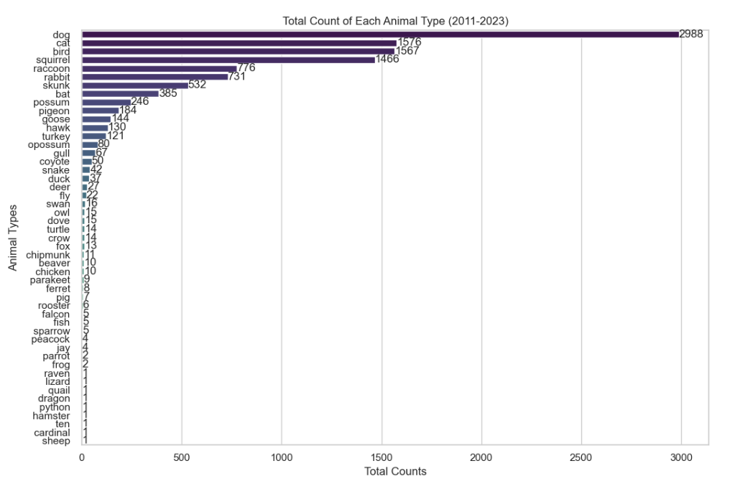
What kinds of animals are most common in complaints?
Trends
The bar graph shows that most of the reports come from the top 4 animals (Dog, Cat, Bird, Squirrel)
Other animals are usually one-off instances that could be considered special cases
Analysis
A significant amount of reports could be pets and the rest are wild animals, however, we don’t know if incidents animals such as cat or birds are for pets or for strays, probably a mix of both
Higher pet ownership rates codes could contribute to the number of reports
Most of the resources can be dedicated to handling a certain type of animals

Slide 25
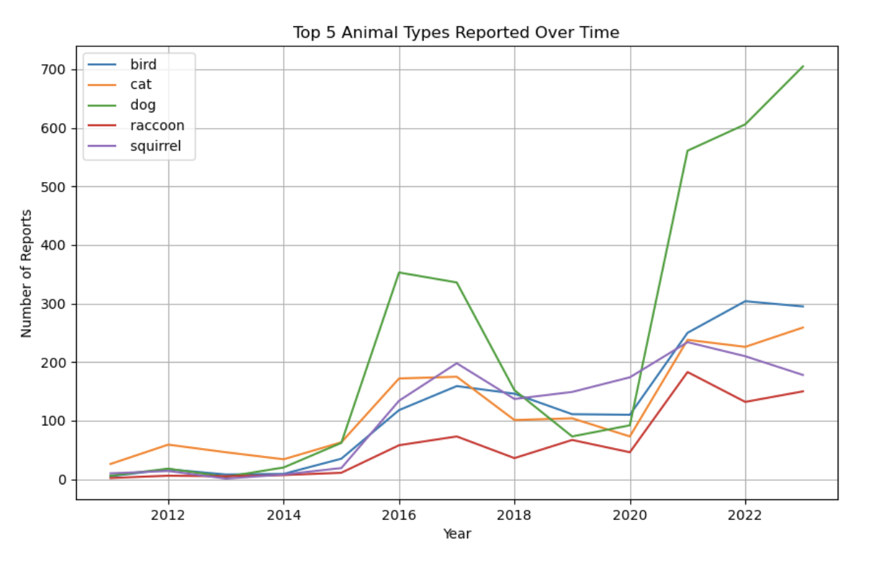
Trends
The bar graph shows the number of reports of the top 5 animals
All animal reports are steadily increasing year by year, and there is a bit of an uptick right after 2020
Dogs are the only animal that show a significant jump in both 2016/7 and after 2020, much more than any other animal
Analysis
Dog reports are increasing at a much higher rate than any other animal, this could either be due to more pet owners moving in or more people having dogs as pets
Adopting pets during quarantine was a very popular trend which could contribute to the rise of dog reports after 2020.

Slide 26
Final Project Updates

Slide 27
Extension Project
Other Added
How does the environment (demographics/clustered locations/weather) impact the likelihood of report in every zip code?
Demographic information based on zip code (population density, land amount)
https://www.unitedstateszipcodes.org/
Cluster density in zip codes based on lat and long of request
Days of extreme weather such as hurricane or winter storm
How many requests were never closed?
If a request gets closed, how many are late at the time of their closing per year?
sla_target_dt: > closed_dt:
Request Type Percentages

Slide 28
REQUEST STATUS
Case_staus: Closed (recorded closed date) or Open (No closed date)
On_time: Overdue/Late (closed date > target date) or Ontime (closed date < target date)

Slide 29
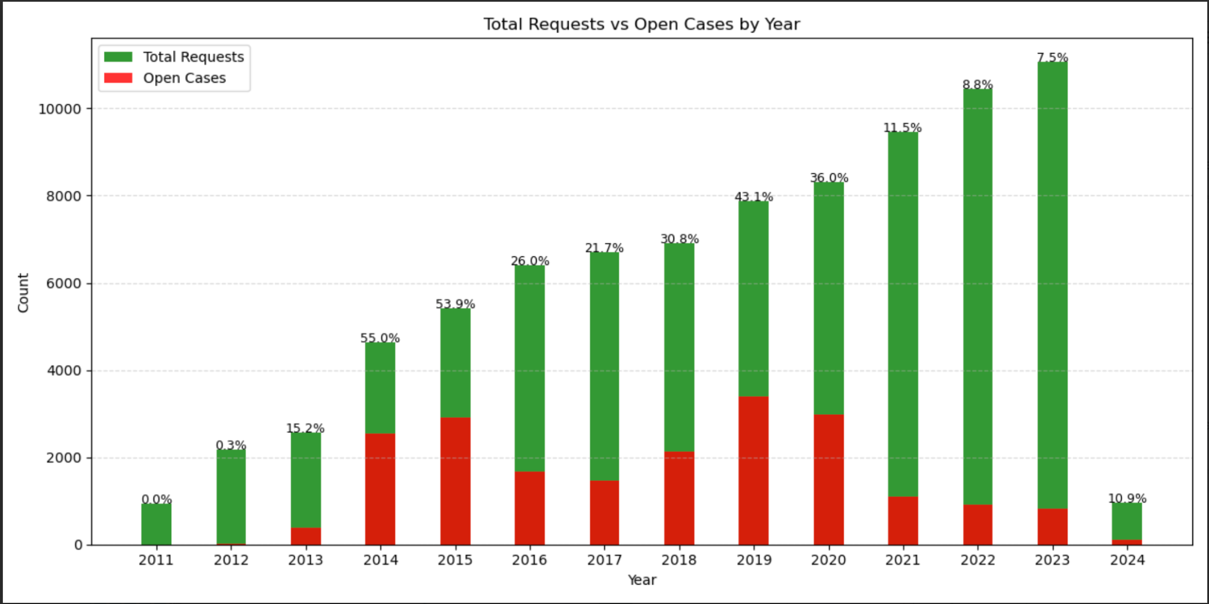
TRENDS:
2014 and 2015 have the highest ratio of open to total cases, around 50 percent
In recent years, the number of open cases is lower
ANALYSIS:
Perhaps years prior had different ways of documenting cases that can not be closed for any reason
Due to decreases open case ratio, perhaps there is a better job at following through with cases until they close

Slide 30
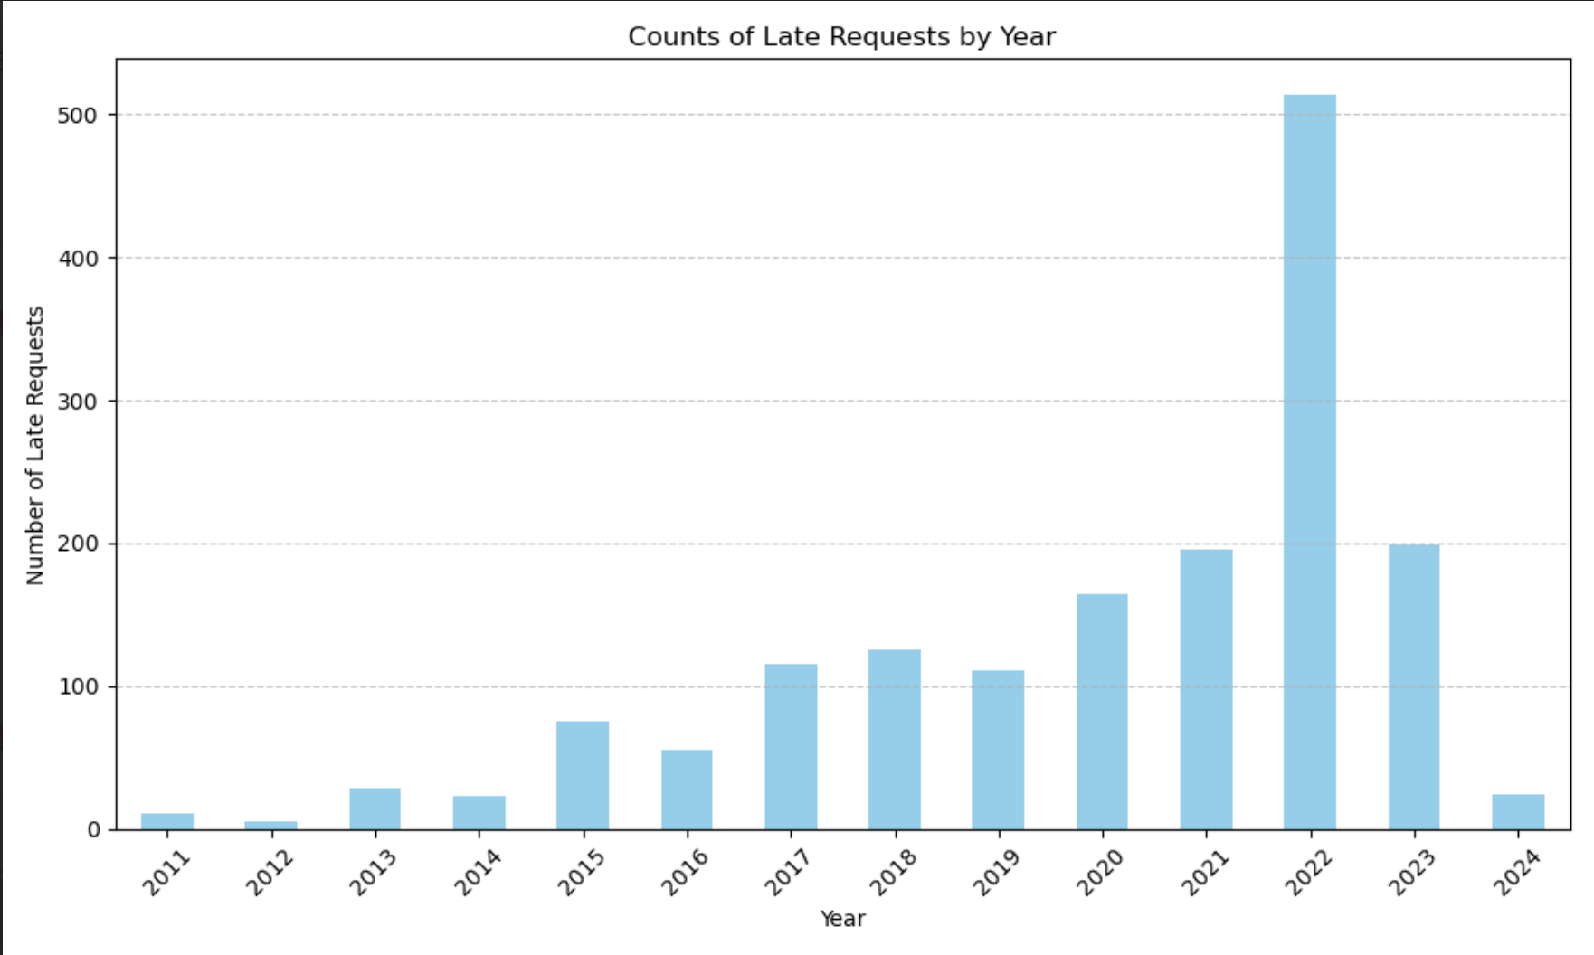
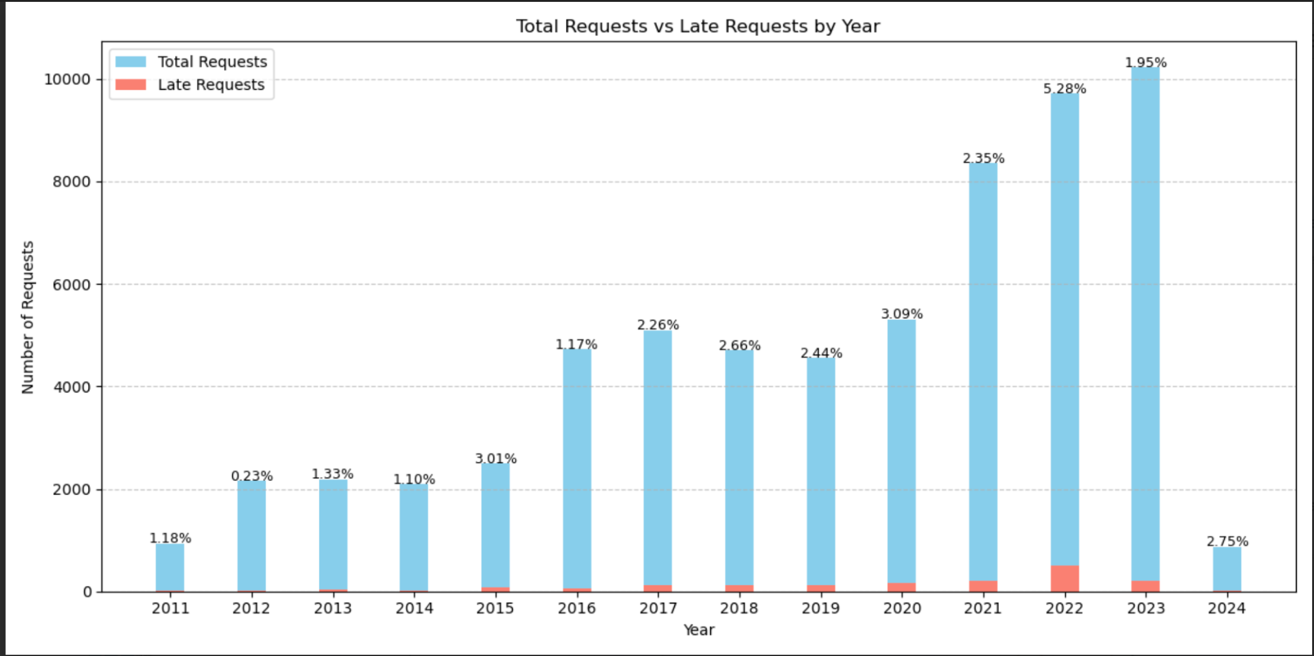
TRENDS:
High amount of late counts in 2022
Increase in late counts toward 2022, but then a correction after
ANALYSIS: The percentage of late count seems to be pretty similar across each year, but 2022 seems to be an outlier with a large percentage.

Slide 31
REQUEST TYPE

Slide 32
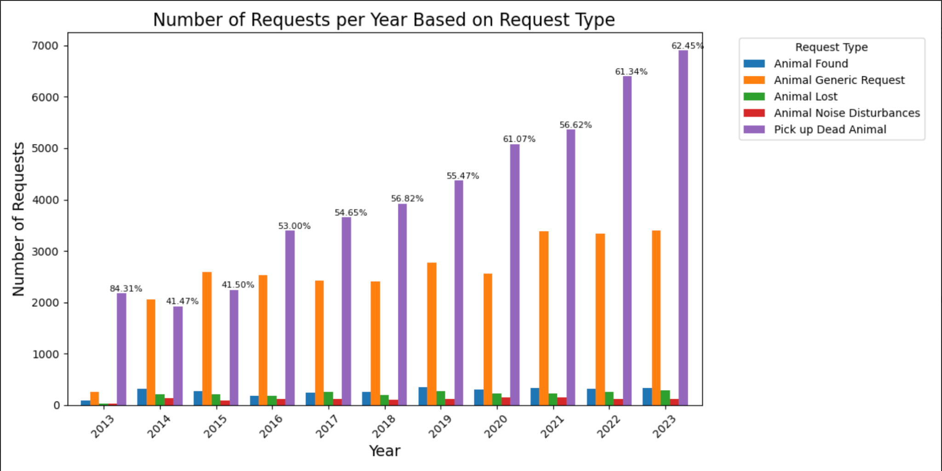
TRENDS:
In recent years, there's been an increase in Pick up Dead Animal requests
In 2023, 62% of all requests were Pick up Dead Animal
ANALYSIS:
Perhaps there is a more proactive approach in managing deceased wildlife in public spaces that is causing an uptick in reporting

Slide 33
EXTENSION PROJECT

Slide 34
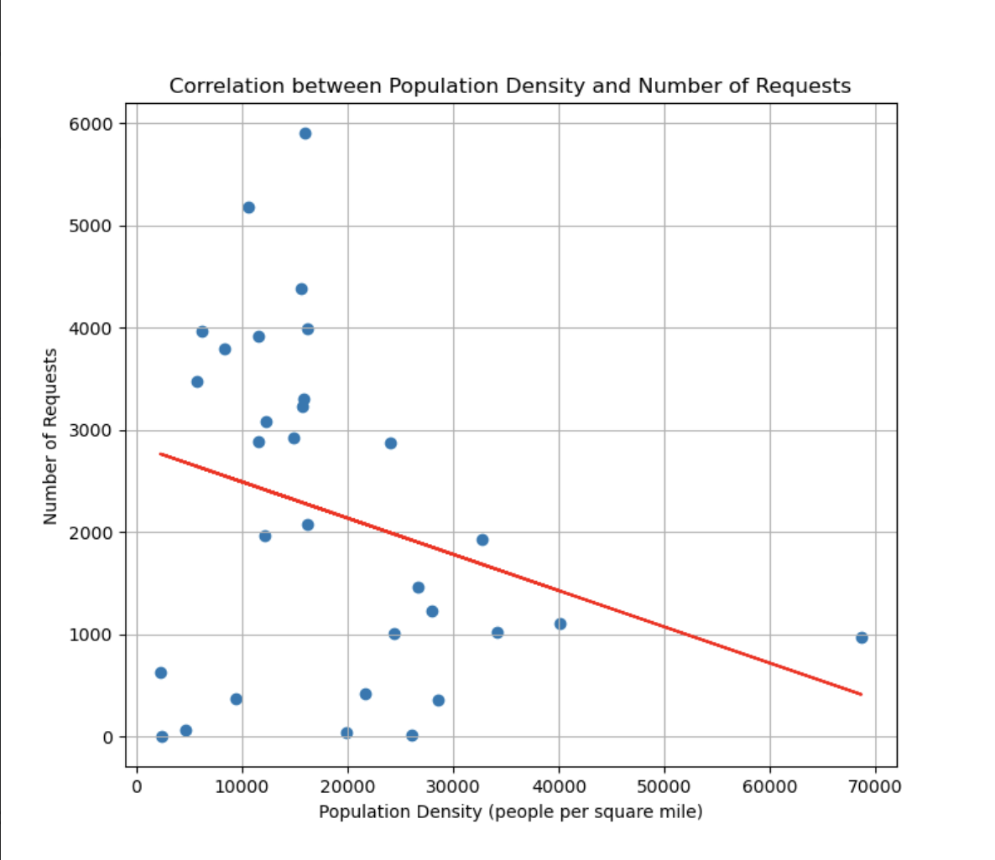
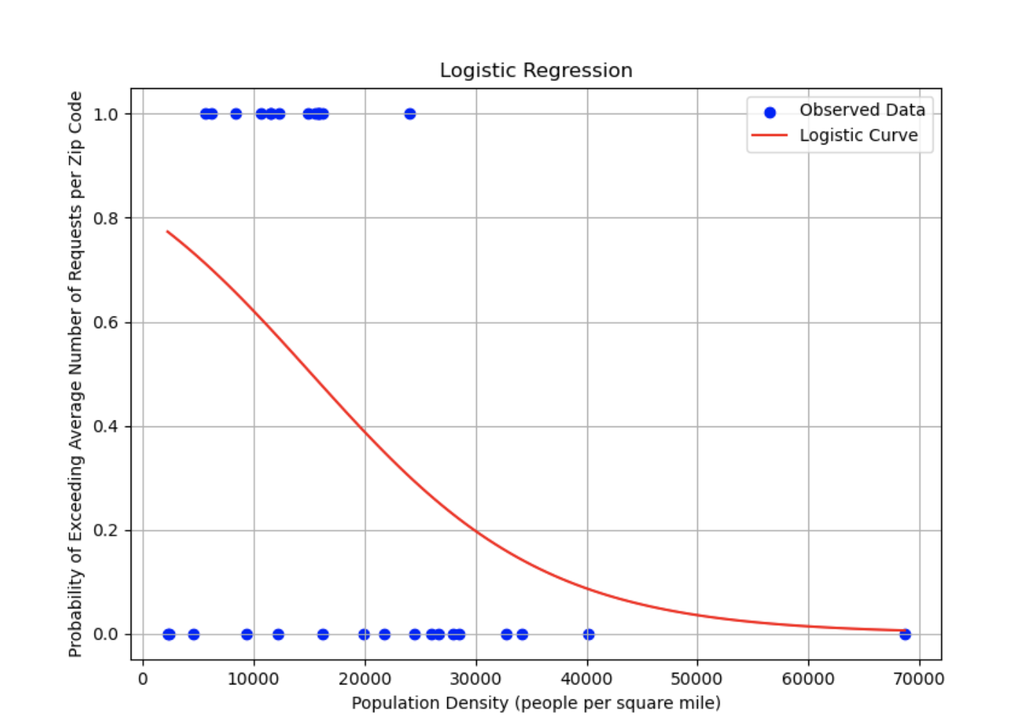
Demographic Information (Population Density)
Analysis:
As population density decreases, there are less humans to report requests
As population density increases there are more humans to report requests and more animals take up the space not used by humans
As population density increases even further, humans start taking up a lot of space than animals, and therefore there are less animals to report
Trends:
Less requests in zip codes with with lower population density
Many requests in zip codes with medium population density
Less requests in zip codes with higher population density

Slide 35
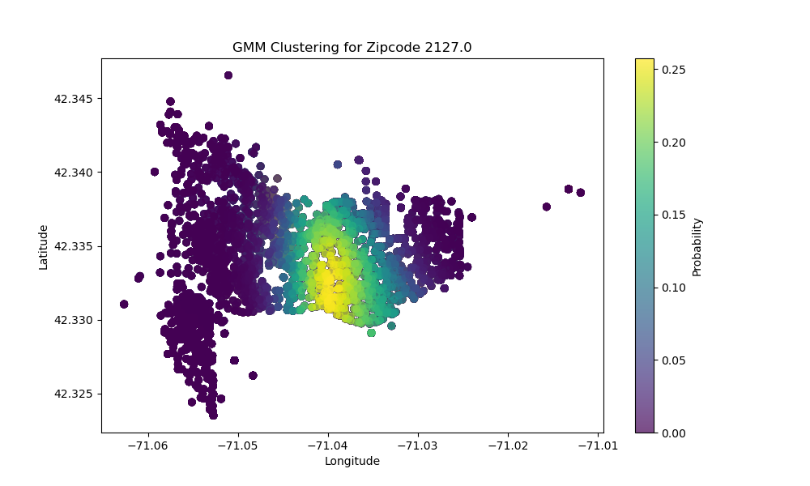
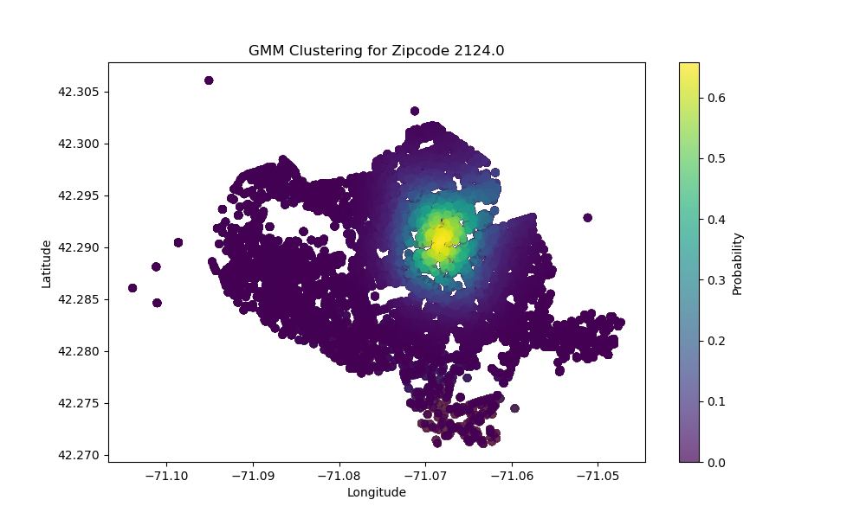
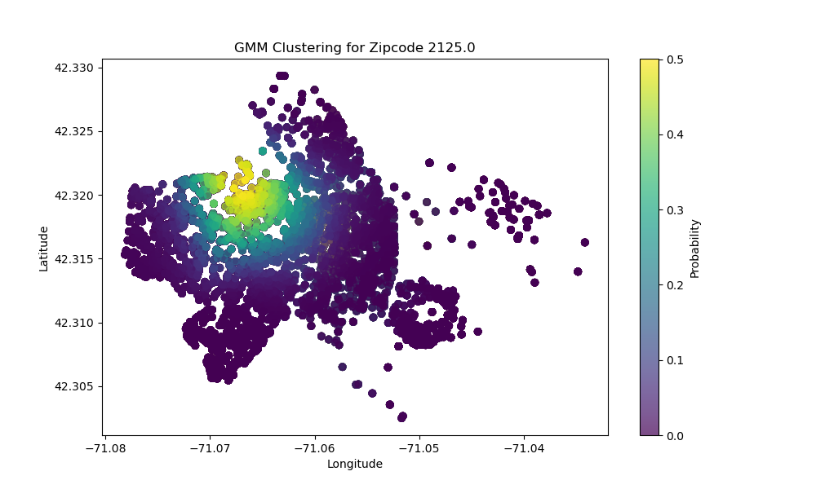
Clusters Per Zip Code
Analysis:
Using density based clustering, “hot spots” of each zipcode have been identified
Each hotspot has varying degrees of spread, meaning in some zip codes the complaints are more widespread vs. centered around one area

Slide 36
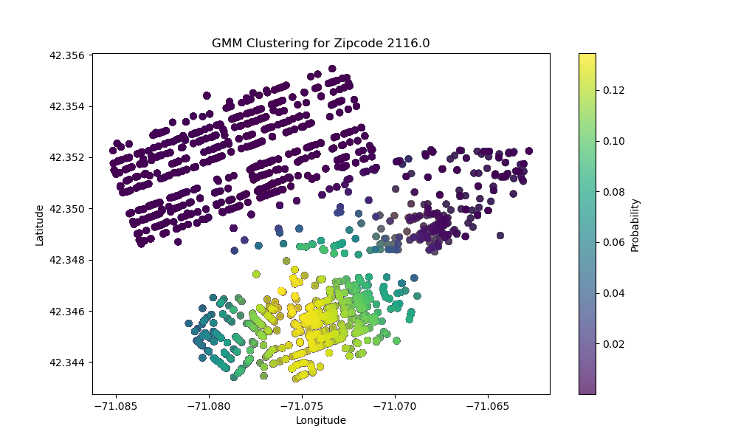
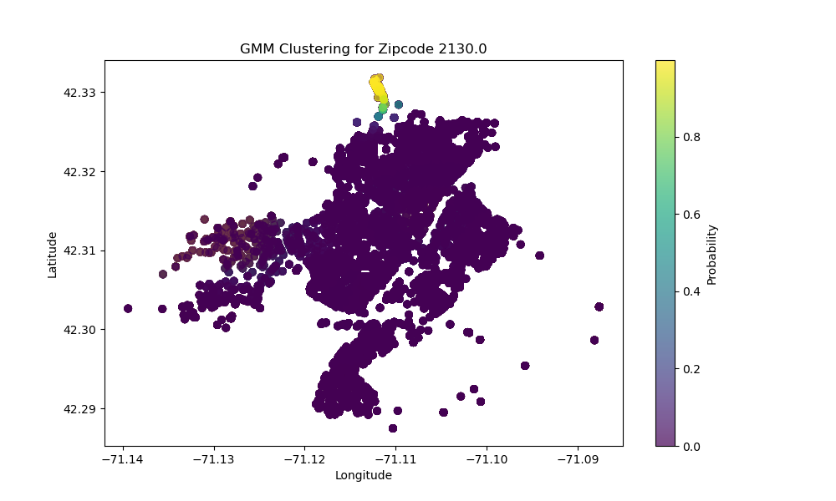
Different Types of Density Spreads
Back Bay
Less dense
Can see the lines of residential spread
Jamaica Plains
More Dense

Slide 37
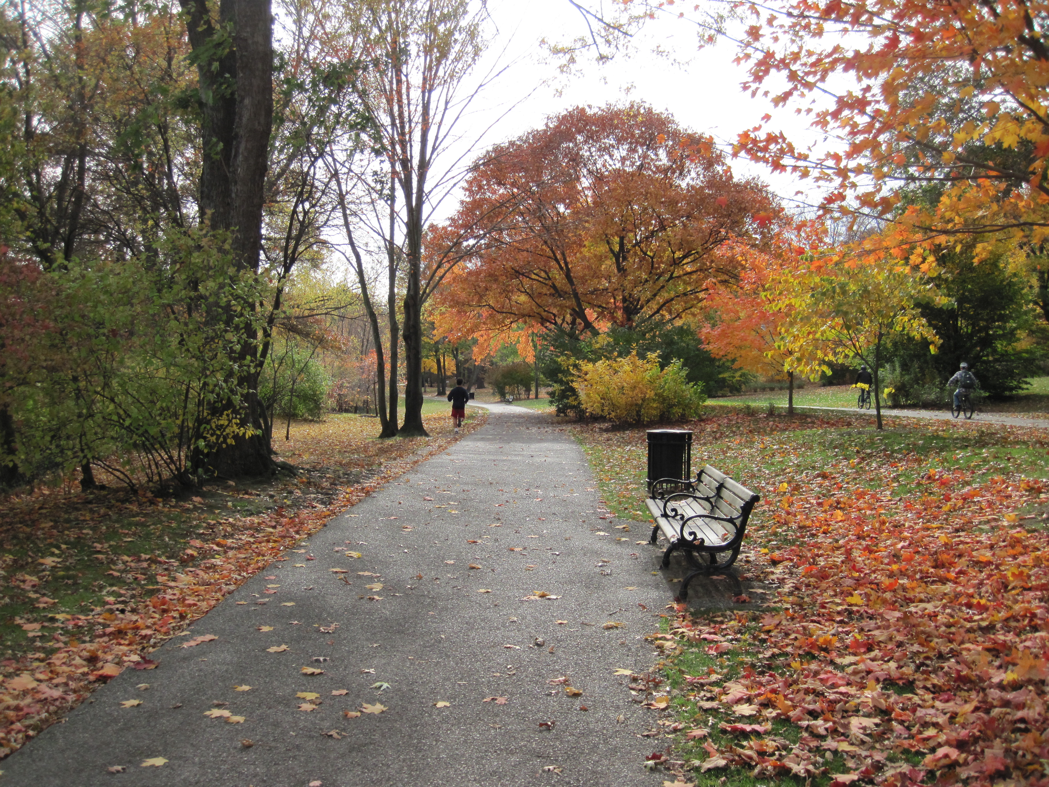
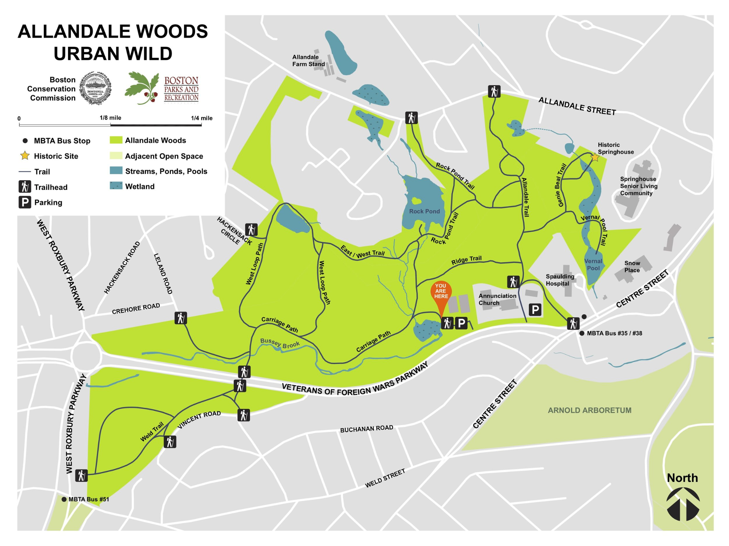
Lining Up with Real World Locations
Olmsted Park in the top middle
Lines up with Allandale Woods on the middle left
Jamaica Plains

Slide 38
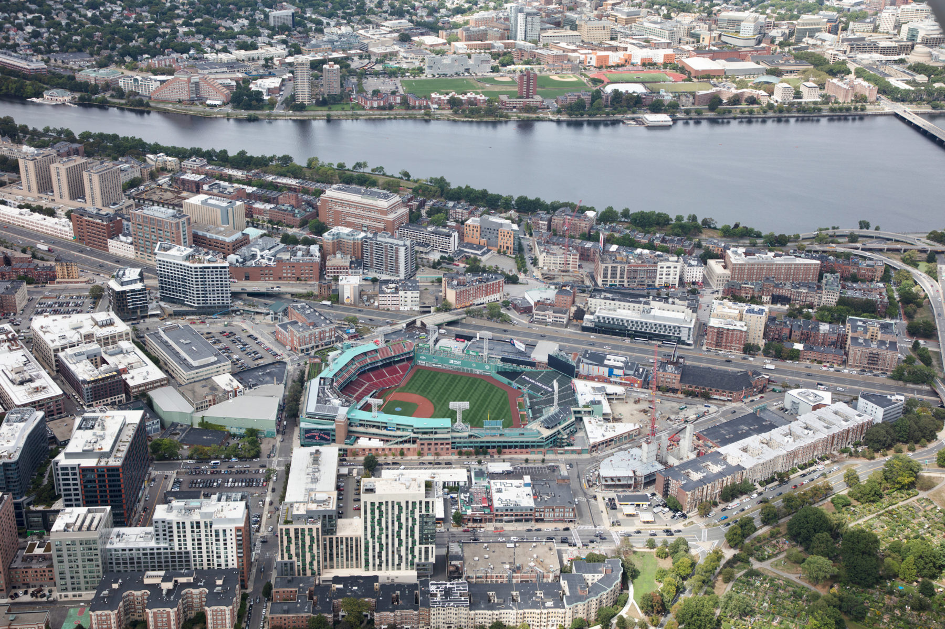
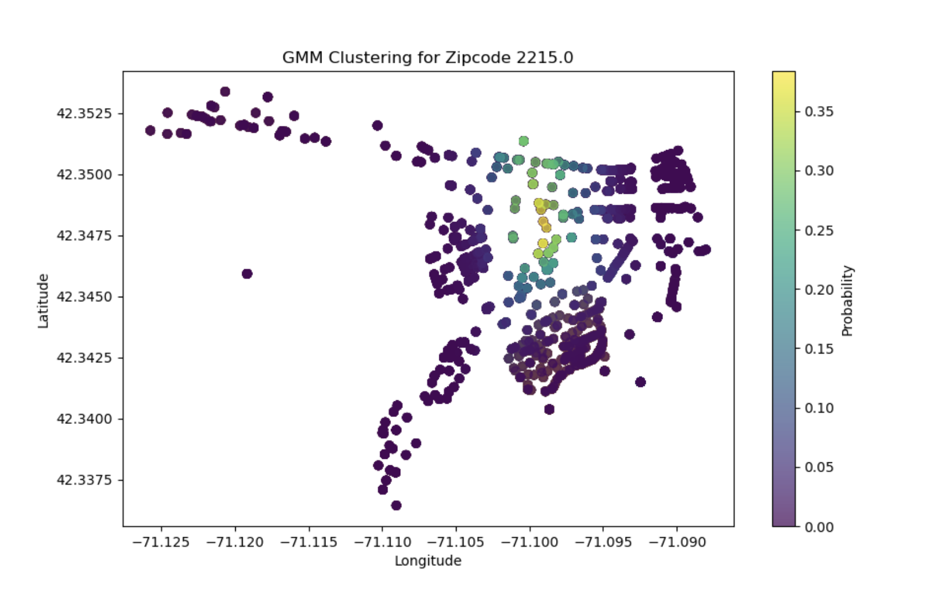
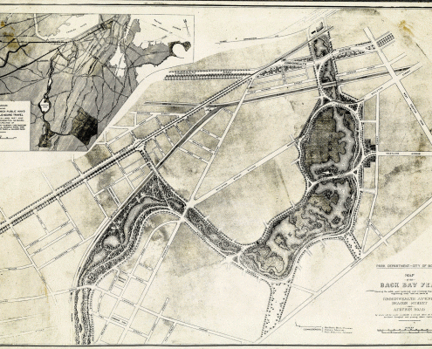
Lining Up with Real World Locations Continued
Fenway Area
Densely populated area
Lines up with Back Bay Fens
A lot of land for animals
Commonwealth/BU Campus

Slide 39
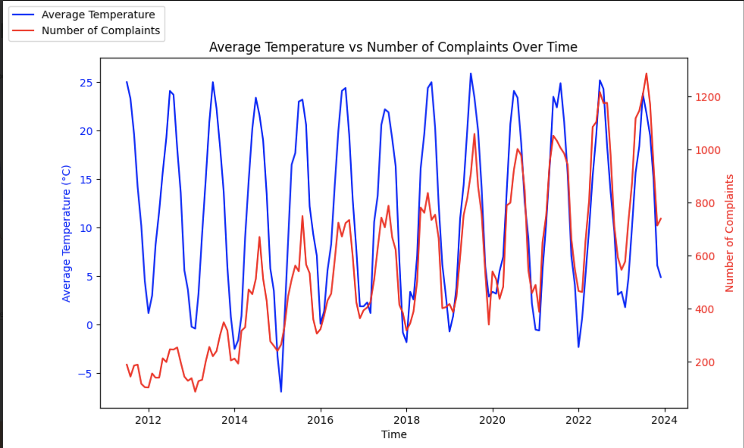
Average Temperatures
TRENDS:
Number of requests is strongly positively correlated to higher temperatures
ANALYSIS:
Similar rationale to seasons with increased requests
More people may be outside to see animals and make reports

Slide 40
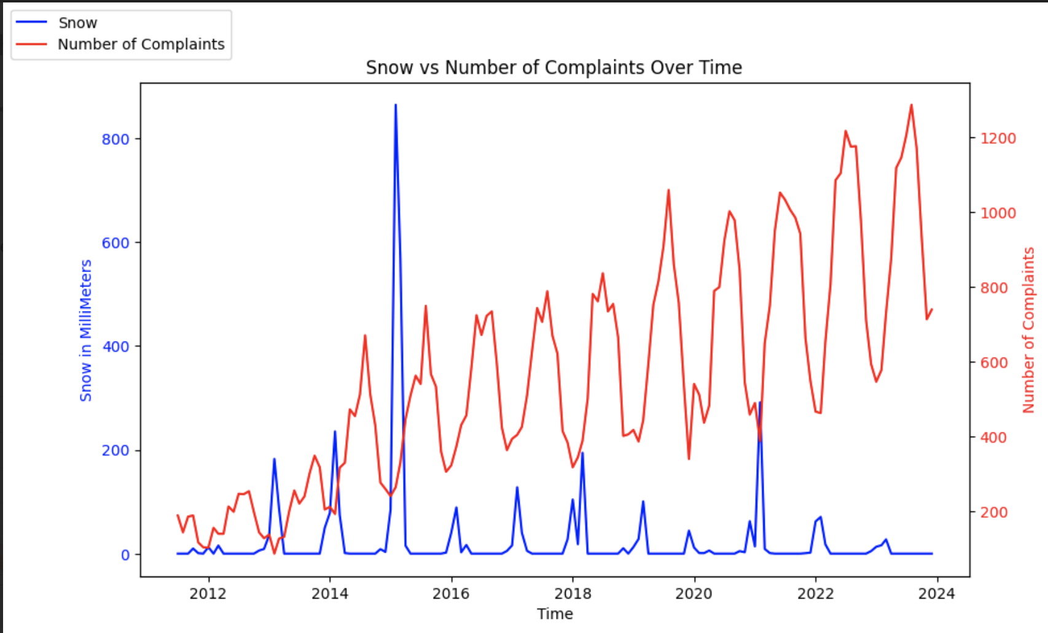
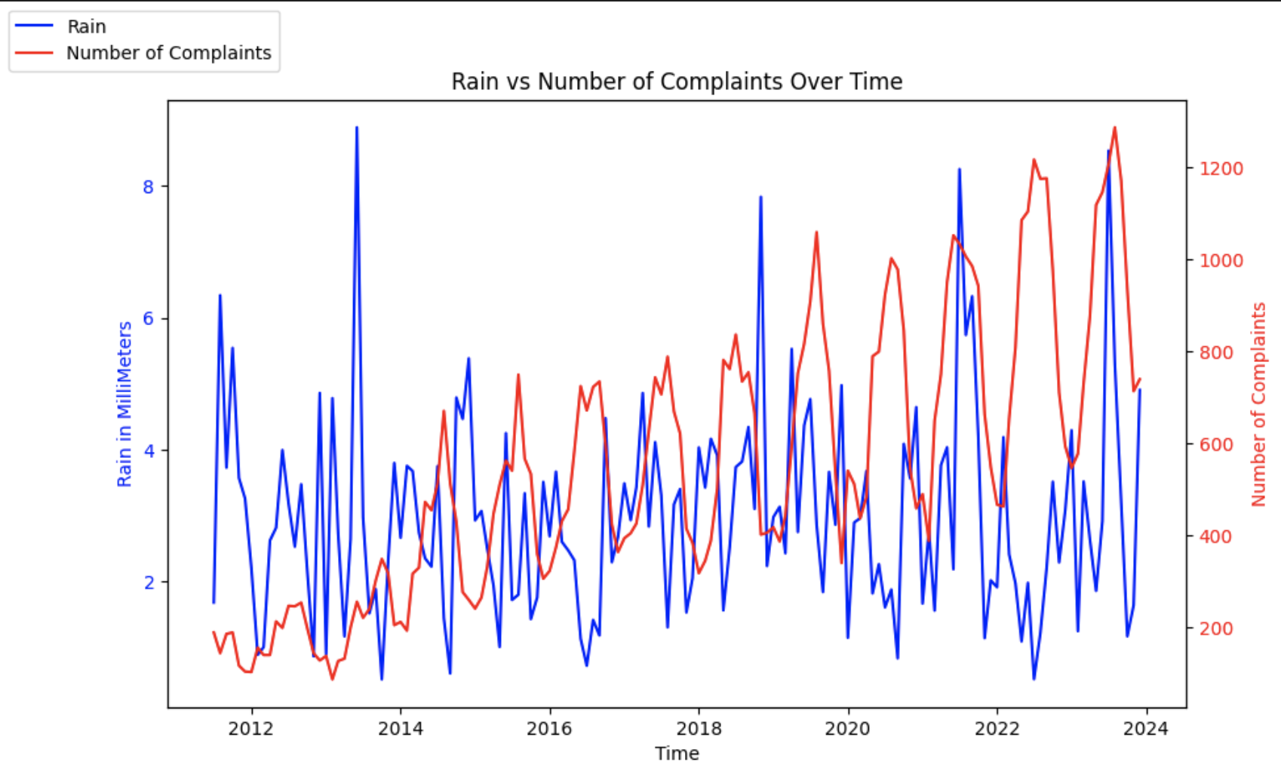
Amount of Rain and Snow
ANALYSIS:
No correlation between snow amount and request number
Amount of rain may look like it correlates with number of requests, but upon closer analysis, it seems random
Data Source: Meteotsat python library
https://dev.meteostat.net/python/#installation

Slide 41
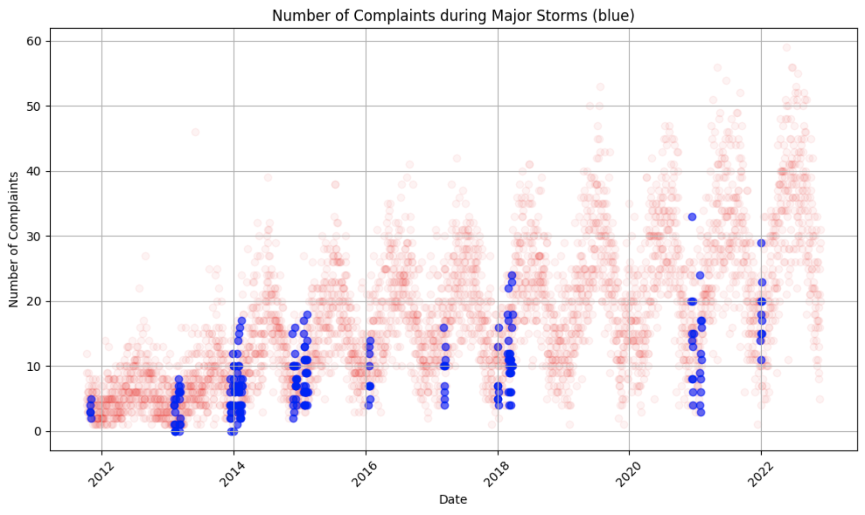
Extreme Weather (Hurricane, Winter storm)
Data From Wikipedia:
“List of New England Hurricanes.” Wikipedia, Wikimedia Foundation, 2 Nov. 2023, en.wikipedia.org/wiki/List_of_New_England_hurricanes.
“List of Northeast Snowfall Impact Scale Winter Storms.” Wikipedia, Wikimedia Foundation, 2 Apr. 2024, en.wikipedia.org/wiki/List_of_Northeast_snowfall_impact_scale_winter_storms.
ANALYSIS:
No correlation between number of requests and cases of extreme weather such as hurricanes or winter storms
Future aim could look at other extreme weather that there is no data for like earthquakes or heat waves

Slide 42
Limitations/Roadblocks
Errors/Inconsistencies with recorded time data
Some duplicate rows, may have slightly impacted counts
Some requests are labeled open (cases_status) and ontime (on_time) and don't have a target date or completion date
They are just ignored but will never be completed (Impacts graph validity/may cause confusion in analysis)
There weren't a lot of large hurricanes or extreme weather to measure from the 2010-2024 (mostly category 1)

Slide 43
Citations
“311 Service Requests - Dataset.” Analyze Boston, data.boston.gov/dataset/311-service-requests.
“List of New England Hurricanes.” Wikipedia, Wikimedia Foundation, 2 Nov. 2023, en.wikipedia.org/wiki/List_of_New_England_hurricanes.
“List of Northeast Snowfall Impact Scale Winter Storms.” Wikipedia, Wikimedia Foundation, 2 Apr. 2024, en.wikipedia.org/wiki/List_of_Northeast_snowfall_impact_scale_winter_storms.
“U.S. ZIP Codes: Free Zip Code Map and ZIP Code Lookup.” United States Zip Codes, www.unitedstateszipcodes.org/.

